Slide 1


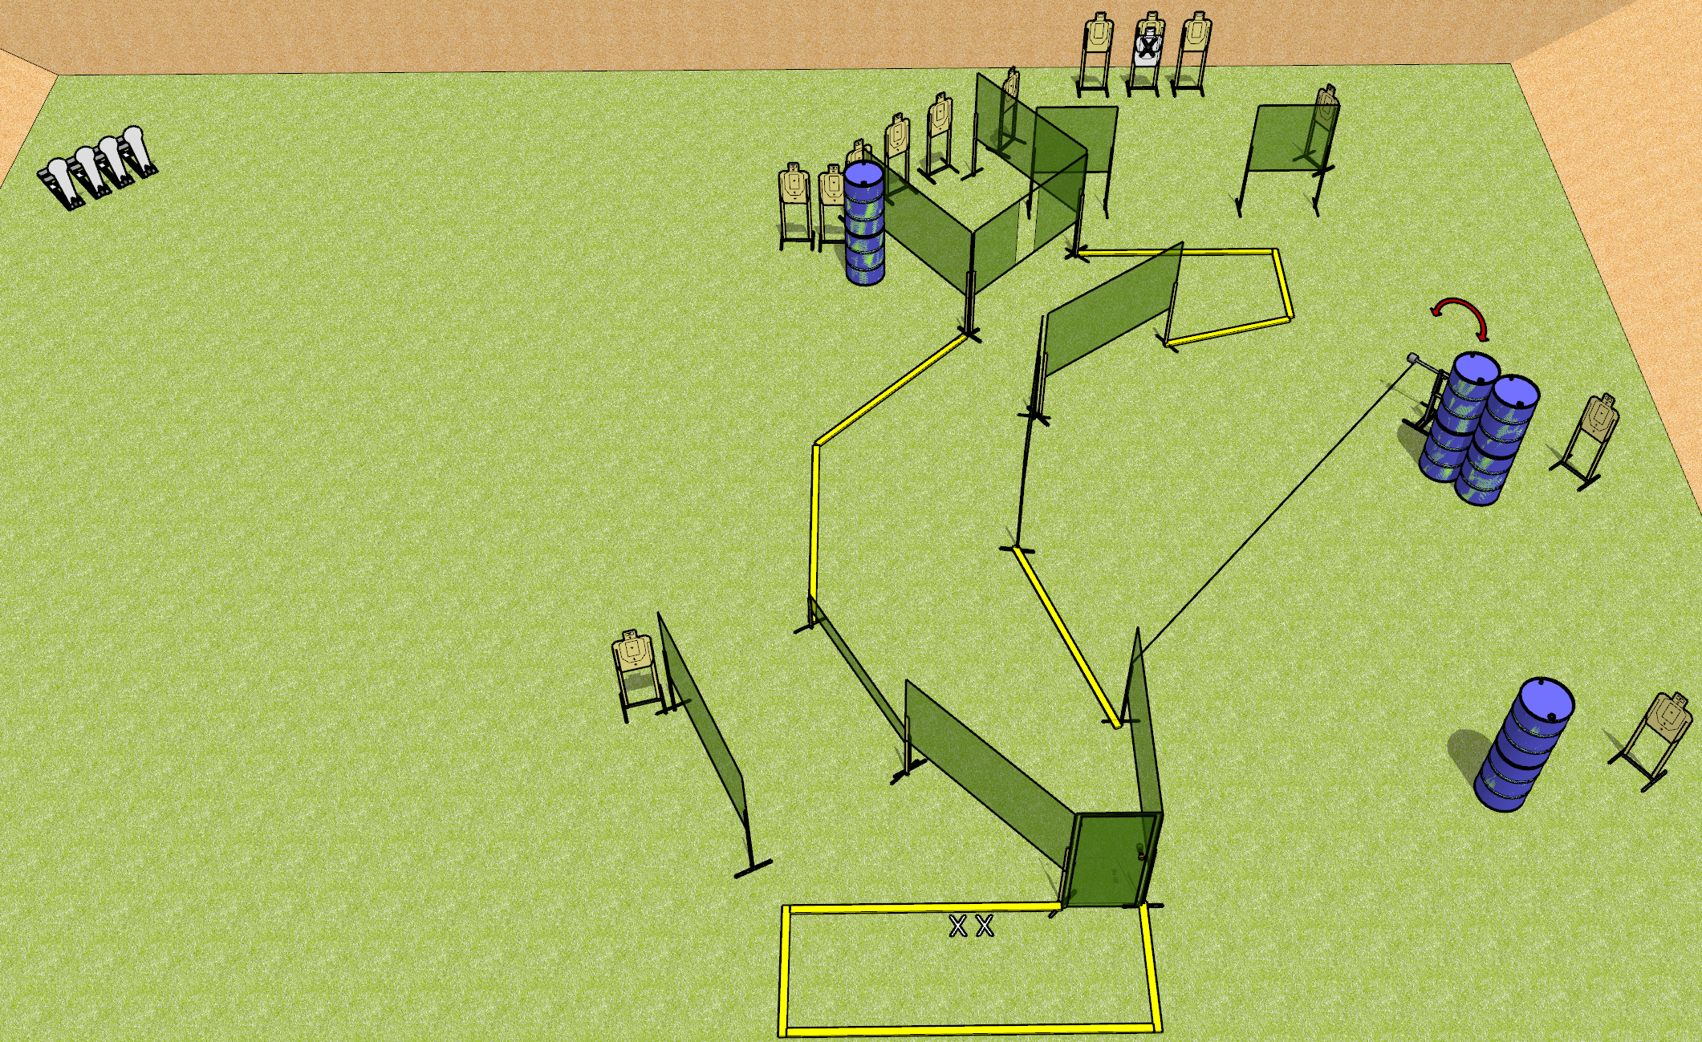
 | Dothan Gun Club – USPSA Match Doorway To The Fun Zone Course Designer : Drew Coleman
Round Count 32 rounds 14 USPSA 4 colt poppers
Equipment List 1 swinger + door + activator + wall with eyelet 4 medium fault lines 15 targets (14 score + 1 NS) Low wall

Slide 2
Doorway To The Fun Zone
Written Stage Briefing
Doorway To The Fun Zone is a 32 round, 160 point, Comstock course of fire. There are 14 USPSA targets and 4 colt poppers. The best 2 hits on cardboard will score and steel must fall to score.
The swinger is activated by the door and remains visible at rest.
Handgun start position is feet on X’s, wrists below belt. Handgun is loaded and holstered.
PCC start position is feet on X’s, stock on belt. Loaded carbine is held with both hands, safety on.
On the audible start signal, engage targets as they become available from within the shooting area.

